Slide 1
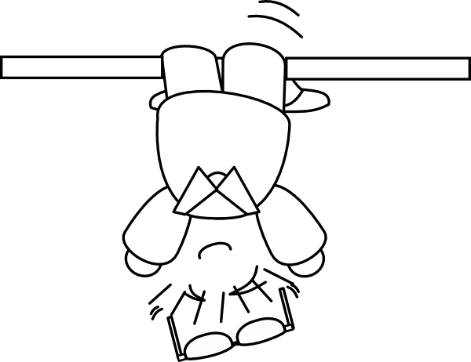
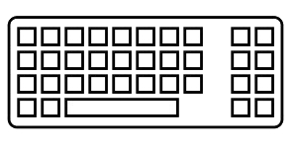
Coding backwards
in order to
to think straight
Initiation to
TDD
(Test Driven Development)

Slide 2
So, TDD …
… what is that?

Slide 3

It is a practice …
… a development one

Slide 4
It is a practice …
… a development one
It is not a testing practice
Its purpose is to create production code
Test coverage is a welcome side-effect
It is only one of XP practices (which are complementary)

Slide 5
RED
REFACTOR
GREEN

Slide 6
RED
Write a single test and watch it fail

Slide 7
RED
Write just enough code to make
the test pass
Write a single test and watch it fail
GREEN

Slide 8
RED
Write just enough code to make
the test pass
Write a single test and watch it fail
REFACTOR
GREEN
Improve the quality of the code, and also of the test

Slide 9
Consider the requirement
RED
Write just enough code to make
the test pass
Write a single test and watch it fail
REFACTOR
GREEN
Improve the quality of the code, and also of the test

Slide 10
Consider the requirement
RED
Write just enough code to make
the test pass
Write a single test and watch it fail
REFACTOR
GREEN
The main design effort occurs here
Improve the quality of the code, and also of the test

Slide 11
Okay, but …
… for what purpose?

Slide 12

Higher Quality

Slide 13
Higher Quality
Users and Business Satisfaction
Product Relialibility and Robusteness
Tolerance to Change
Building Trust and Confidence
Continuous Improvement Cycle

Slide 14
Okay, but …
… how does TDD help in all this?

Slide 15

Cognitive Biases

Slide 16
Cognitive Biases
Four main categories of bias:
- Too much information
- Limits of memory
- Lack of meaning
- Acting in urgency

Slide 17
Cognitive Biases
Four main categories of bias:
- Too much information
- Limits of memory
- Lack of meaning
- Acting in urgency
Confirmation Bias
Testing Effect
Bandwagon Effect
Less-is-better Effect

Slide 18

Attention Span

Slide 19
Attention Span
TDD
Framework to focus on
Milestones over time and progress

Slide 20
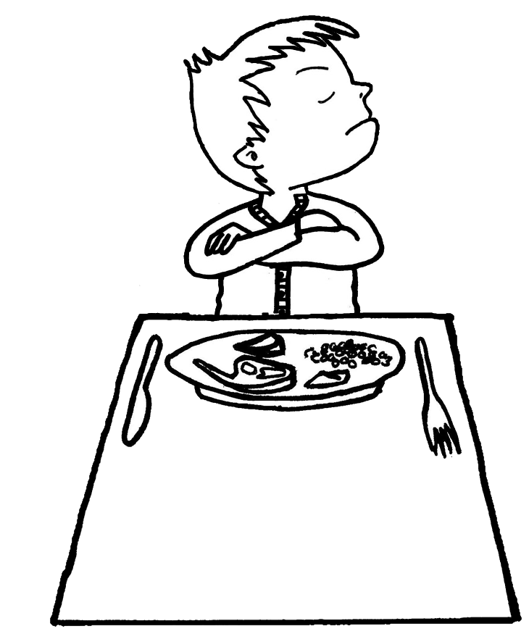
Operant Conditioning

Slide 21
Operant Conditioning
« Green » highlights each achievement
« Red » stresses incompleteness
Confidence increases with each cycle
TDD

Slide 22

Learning Process

Slide 23
Learning Process
Several combined effects:
- Trial and error
- Repetition
- Solution emergence
TDD
Continuous Improvment

Slide 24

Procrastination

Slide 25
Procrastination
TODO

Slide 26
Procrastination
Progress indicator
Iterative process
Tests cannot be forgotten or postponed
TDD

Slide 27
Okay, but …
... why is it so uncommon?

Slide 28

An Emerging Profession

Slide 29
An Emerging Profession
Very little hindsight on the different practices
School curricula are evolving... at their own pace
A high overall complexity of the variables involved

Slide 30

Easy from a distance...
... far from being easy

Slide 31
Easy from a distance...
... far from being easy
Changing work habits
Conforming to a constrained cycle
Understanding before coding
It is a practice, not a silver bullet, not a dogma

Slide 32

A « Magnifying » Effect

Slide 33
A « Magnifying » Effect
Colliding with existing code
Discovering problems:
- design
- expression of requirements
- organization …
need to accept them and improve ourselves
Do not blame the practice for what it reveals

Slide 34
Let's get back to the point …
… TDD is therefore:

Slide 35
Consider the requirement
RED
Write just enough code to make
the test pass
Write a single test and watch it fail
REFACTOR
GREEN
The main design effort occurs here
Improve the quality of the code, and also of the test

Slide 36
Okay, but speaking of design...
… what is good design?

Slide 37
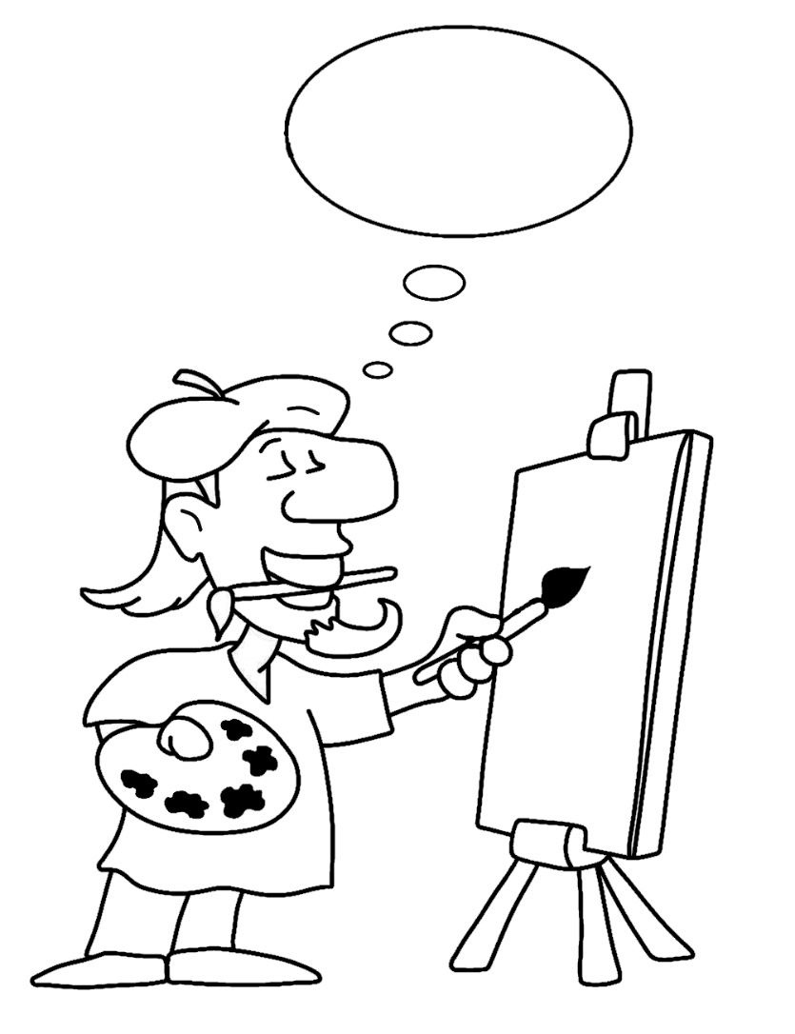
Three main
Categories of Design

Slide 38
Three main
Categories of Design
Architecture
Macro design
Micro design

Slide 39
Three main
Categories of Design
Architecture
Macro design
Micro design
= infrastructure, persistence …
= packages, dependencies …
= business code, rules …

Slide 40
Three main
Categories of Design
Architecture
Macro design
Micro design
= infrastructure, persistence …
= packages, dependencies …
= business code, rules …
TDD

Slide 41
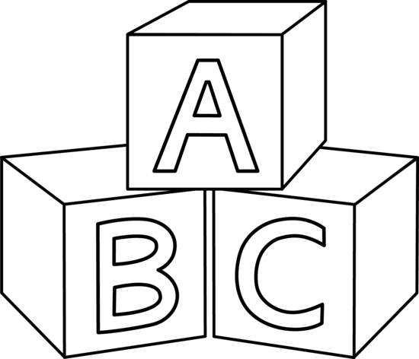
Four Rules
of Simple Design

Slide 42
Four Rules
of Simple Design
Passes the tests
Reveals intention
No duplication
Fewest elements

Slide 43
Four Rules
of Simple Design
Passes the tests
Reveals intention
No duplication
Fewest elements
+
Priority
-

Slide 44
Okay, but …
… that's not enough!

Slide 45

It's a long way to go

Slide 46
It's a long way to go
Design Patterns
SOLID Principles
Clean Code
Domain Driven Design
…

Slide 47
So …
… how do we get started ?

Slide 48

Some guidelines
for the TDD cycle

Slide 49
Some guidelines
for the TDD cycle
Add one (and only one) new test while in « Green »
Watch the test fail before coding corresponding solution
Code in order to return as soon as possible to « Green »
Refactor code or test at any one time, not both

Slide 50

Anatomy of a Test

Slide 51
Anatomy of a Test
GIVEN
WHEN
THEN

Slide 52
Anatomy of a Test
GIVEN
WHEN
THEN
Context
Event
Expectation

Slide 53
Anatomy of a Test
GIVEN
WHEN
THEN
Context
Event
Expectation
= states / data
= what is being tested
= solution to the requirement

Slide 54
Anatomy of a Test
3
GIVEN
WHEN
THEN
Context
Event
Expectation
= states / data
= what is being tested
= solution to the requirement
2
1

Slide 55
Consider the requirement
RED
Write just enough code to make
the test pass
Write a single test and watch it fail
REFACTOR
GREEN
The main design effort occurs here
Improve the quality of the code, and also of the test

Slide 56
In the end, the key is ...
… practicing!

Slide 57
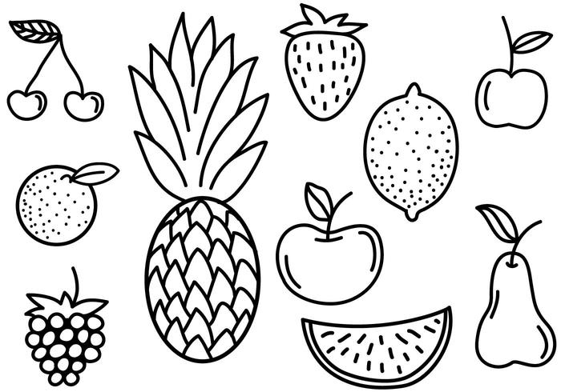
Fruit Shop
Charge the right amount when the customer goes to the checkout.
Business rules (prices in cents):
1 apple costs 100
1 banana costs 150
1 cherry costs 75

Slide 58
@Test public void noCheckoutForEmptyCart() { }

Slide 59
@Test public void noCheckoutForEmptyCart() { // THEN assertThat(totalAmount).isEqualTo(0); }

Slide 60
@Test public void noCheckoutForEmptyCart() { // WHEN int totalAmount = cart.computeTotalAmount(); // THEN assertThat(totalAmount).isEqualTo(0); }

Slide 61
@Test public void noCheckoutForEmptyCart() { // GIVEN Cart cart = new Cart(); // WHEN int totalAmount = cart.computeTotalAmount(); // THEN assertThat(totalAmount).isEqualTo(0); }

Slide 62
Fruit Shop
Charge the right amount when the customer goes to the checkout.
Business rules (prices in cents):
1 apple costs 100
1 banana costs 150
1 cherry costs 75

Slide 63
Fruit Shop
Charge the right amount when the customer goes to the checkout.
Business rules (prices in cents):
1 apple costs 100
1 free apple when two bought apples
1 banana costs 150
1 cherry costs 75

Slide 64
Fruit Shop
Charge the right amount when the customer goes to the checkout.
Business rules (prices in cents):
1 apple costs 100
1 free apple when two bought apples
1 banana costs 150
1 cherry costs 75
You have to be able to sell « des pommes » in France

Slide 65
Fruit Shop
Charge the right amount when the customer goes to the checkout.
Business rules (prices in cents):
1 apple costs 100
1 free apple when two bought apples
1 banana costs 150
The second banana is half price
1 cherry costs 75

Slide 66
Fruit Shop
Charge the right amount when the customer goes to the checkout.
Business rules (prices in cents):
1 apple costs 100
1 free apple when two bought apples
1 banana costs 150
The second banana is half price
1 cherry costs 75
A loyalty program customer is entitled to a 10% discount

Slide 67


